Slide 1
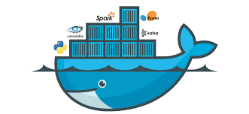
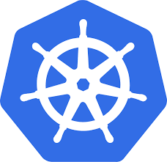
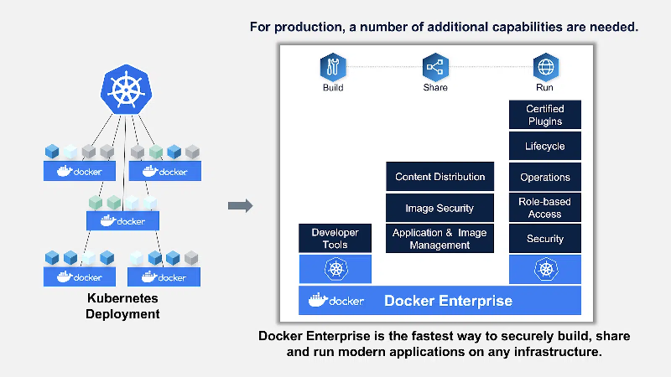
Dockers & Kubernetes

Slide 2
Docker Overview
Docker is an open platform for developing, shipping, and running applications. Docker enables you to separate your applications from your infrastructure so you can deliver software quickly. With Docker, you can manage your infrastructure in the same ways you manage your applications. By taking advantage of Docker’s methodologies for shipping, testing, and deploying code quickly, you can significantly reduce the delay between writing code and running it in production.
Similar to shipping containers: The container is always the same, regardless of the contents and thus fits on all trucks, cranes, ships..

Slide 3
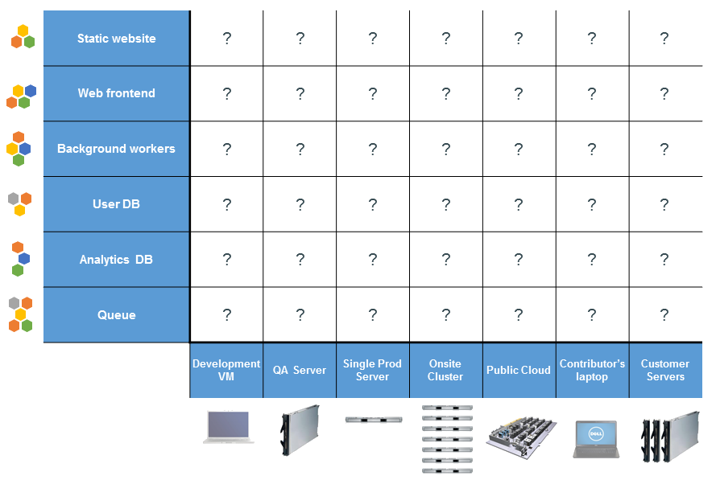
The Challenge – The Matrix From Hell

Slide 4
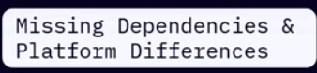
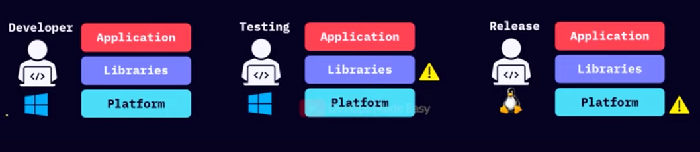
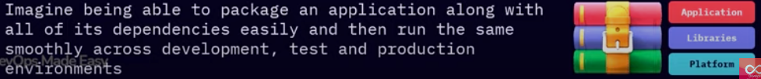

Slide 5
Help From Elsewhere - Shipping Containers
Notes:
Common format for the doors, the hooks, the locking bars, the vents and rails, the floor boards etc

Slide 6
Applied to IT World - Application Containers
Notes:
Standard format for the app, its dependencies, libraries, storage and networking, logging, administration etc

Slide 7
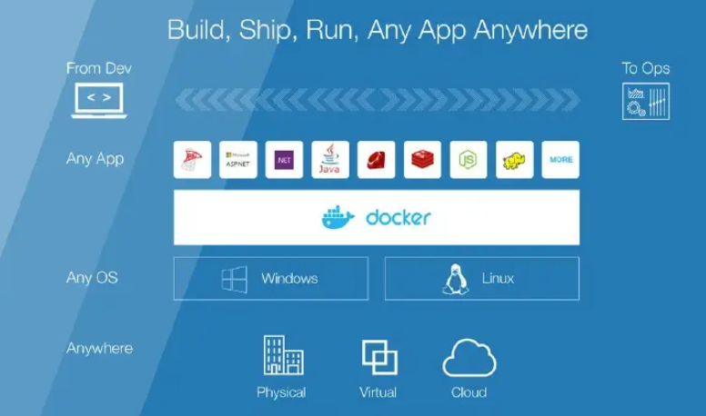
Why Developers care
Build once, run any where
Configure once, run anything

Slide 8
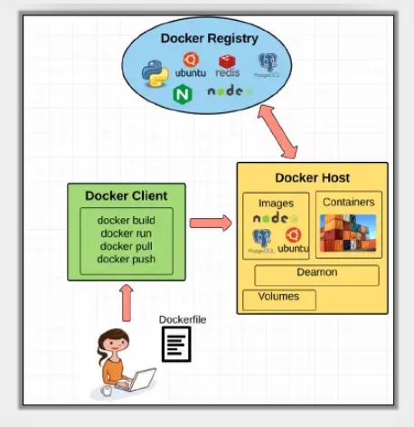
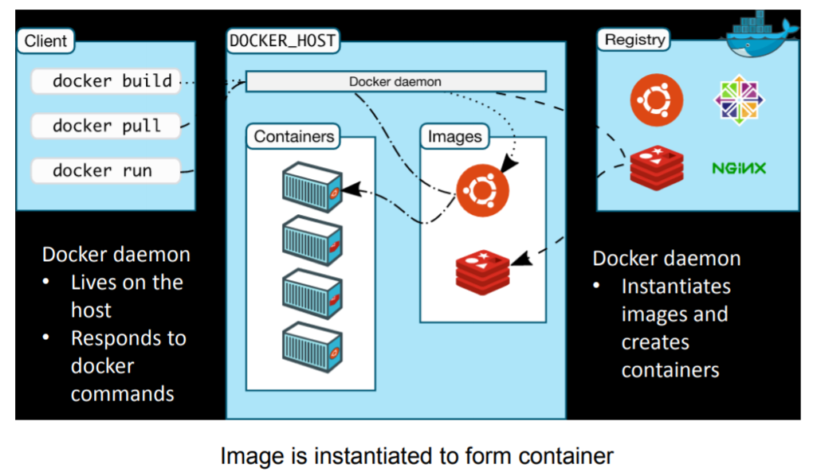
Docker Architecture

Slide 9
Understanding Docker
Docker uses a client-server architecture. The Docker client talks to the Docker daemon, which does the heavy lifting of building, running, and distributing your Docker containers. The Docker client and daemon can run on the same system, or you can connect a Docker client to a remote Docker daemon. The Docker client and daemon communicate using a REST API, over UNIX sockets or a network interface. Another Docker client is Docker Compose, which lets you work with applications consisting of a set of containers.
The Docker daemon (dockerd) listens for Docker API requests and manages Docker objects such as images, containers, networks, and volumes. A daemon can also communicate with other daemons to manage Docker services.
The Docker client (docker) is the primary way that many Docker users interact with Docker. When you use commands such as docker run, the client sends these commands to dockerd, which carries them out. The docker command uses the Docker API. The Docker client can communicate with more than one daemon.

Slide 10
Docker objects
When you use Docker, you are creating and using images, containers, networks, volumes, plugins, and other objects. This section is a brief overview of some of those objects.
Images
An image is a read-only template with instructions for creating a Docker container. Often, an image is based on another image, with some additional customization. For example, you may build an image which is based on the ubuntu image, but installs the Apache web server and your application, as well as the configuration details needed to make your application run. You might create your own images or you might only use those created by others and published in a registry. To build your own image, you create a Dockerfile with a simple syntax for defining the steps needed to create the image and run it. Each instruction in a Dockerfile creates a layer in the image. When you change the Dockerfile and rebuild the image, only those layers which have changed are rebuilt. This is part of what makes images so lightweight, small, and fast, when compared to other virtualization technologies.
Containers
A container is a runnable instance of an image. You can create, start, stop, move, or delete a container using the Docker API or CLI. You can connect a container to one or more networks, attach storage to it, or even create a new image based on its current state. By default, a container is relatively well isolated from other containers and its host machine. You can control how isolated a container’s network, storage, or other underlying subsystems are from other containers or from the host machine. A container is defined by its image as well as any configuration options you provide to it when you create or start it. When a container is removed, any changes to its state that are not stored in persistent storage disappear.
Docker image is a class and container is instance of a class

Slide 11
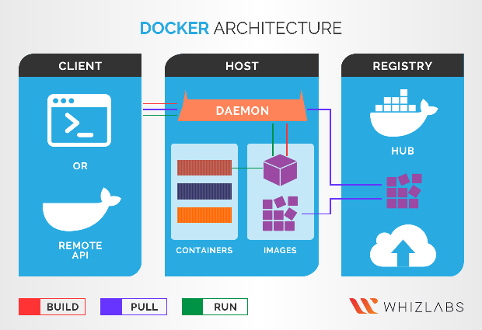
How Does Docker Works?
The Docker architecture consists of four main components along with Docker containers which we’ve covered earlier.
Docker client – the main component to create, manage, and run containerized applications. The Docker client is the primary method of controlling the Docker server via a CLI like Command Prompt (Windows) or Terminal (macOS, Linux).
Docker server – also known as the Docker daemon. It waits for REST API requests made by the Docker client and manages images and containers.
Docker images – instruct the Docker server with the requirements on how to create a Docker container. Images can be downloaded from websites like Docker Hub. Creating a custom image is also possible – to do it, users need to create a Dockerfile and pass it to the server. It’s worth noting that Docker doesn’t clear any unused images, so users need to delete image data themselves before there’s too much of it.
Docker registry – an open-source server-side application used to host and distribute Docker images. The registry is extra useful to store images locally and maintain complete control over them. Alternatively, users can access the aforementioned Docker Hub – the world’s largest repository of Docker images.

Slide 12
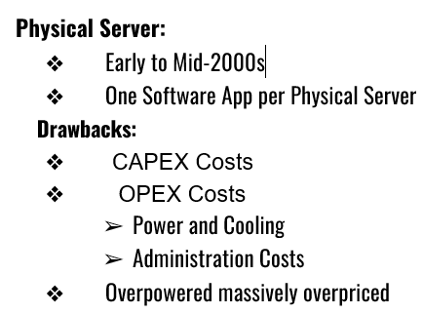
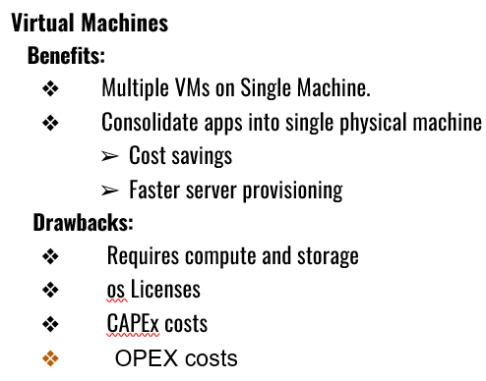
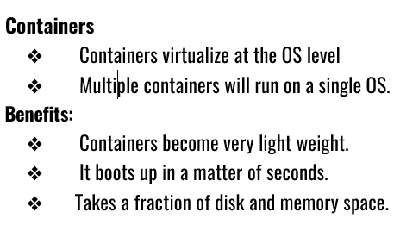
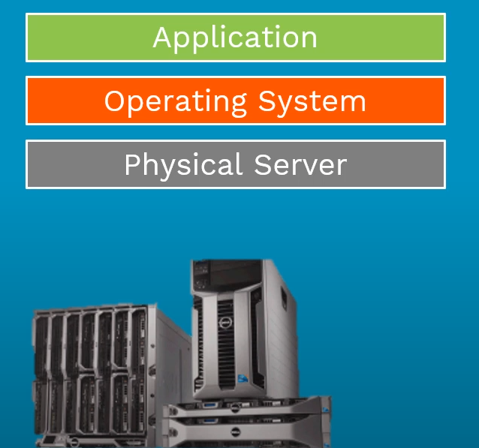
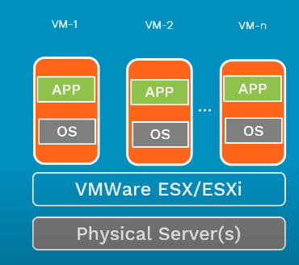
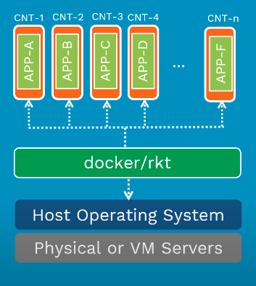
Difference between Physical Server, Virtual Machine and Docker

Slide 13
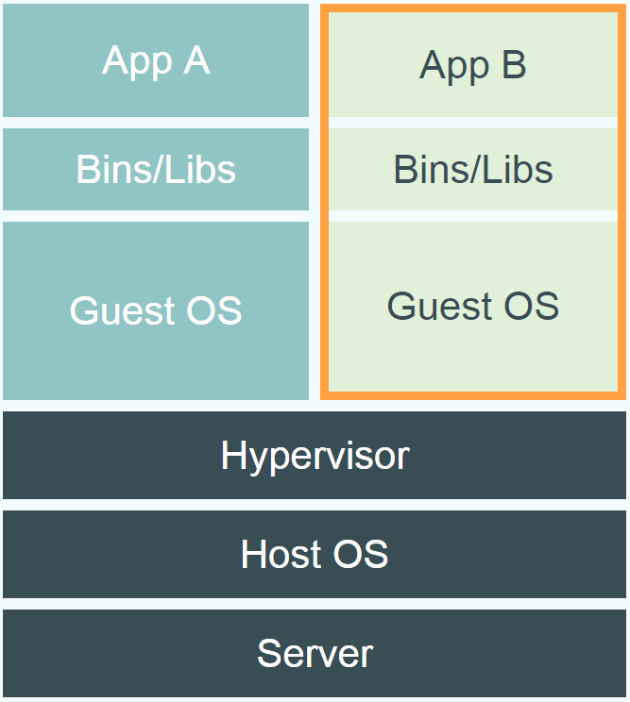
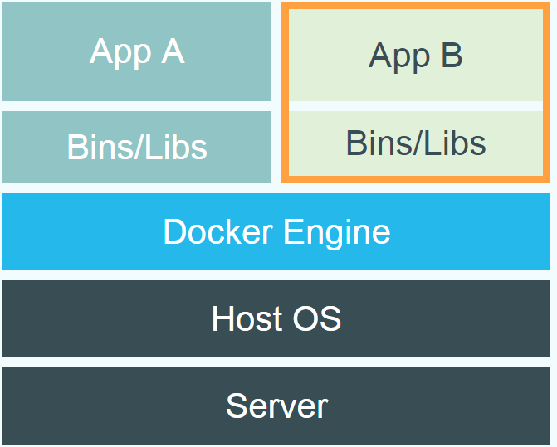
Docker vs. Virtual Machine
Source: https://www.docker.com/whatisdocker/
Notes:
Virtual Machines
Each virtualized application includes not only the application - which may be only 10s of MB - and the necessary binaries and libraries, but also an entire guest operating system - which may weigh 10s of GB.
Docker
The Docker Engine container comprises just the application and its dependencies. It runs as an isolated process in userspace on the host operating system, sharing the kernel with other containers. Thus, it enjoys the resource isolation and allocation benefits of VMs but is much more portable and efficient.
Docker provides base images that contain OS installations we can start from: The OS is not more than an application running on the Kernel...

Slide 14
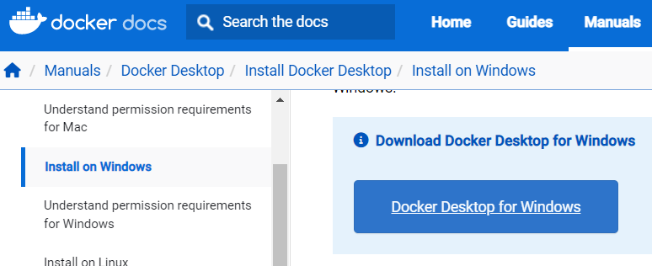
Docker Installation steps on windows
Double-click Docker Desktop Installer.exe to run the installer.
When prompted, ensure the Use WSL 2 instead of Hyper-V option on the Configuration page is selected or not depending on your choice of backend. If your system only supports one of the two options, you will not be able to select which backend to use.
Follow the instructions on the installation wizard to authorize the installer and proceed with the install.
When the installation is successful, click Close to complete the installation process.
To check the docker installation
docker --version
docker run hello-world

Slide 15
Terminology - Image
Terminology - Container
Persisted snapshot that can be run
images: List all local images
run: Create a container from an image and execute a command in it
tag: Tag an image
pull: Download image from repository
rmi: Delete a local image
This will also remove intermediate images if no longer used
Runnable instance of an image
ps: List all running containers
ps –a: List all containers (incl. stopped)
top: Display processes of a container
start: Start a stopped container
stop: Stop a running container
pause: Pause all processes within a container
rm: Delete a container
commit: Create an image from a container

Slide 16
Image vs. Container
Base Image
ubuntu:latest
run
Container
cid1
base image
cmd → new state
New Image
iid1
commit
Container
cid1
run
Container
cid2
Container
cid3
Container
cid4

Slide 17
Hands-on
docker pull ubuntu
docker pull ubuntu:20.04
docker images
This generates a list of images known to Docker on your machine
docker run -ti --rm ubuntu /bin/bash
docker run -ti ubuntu /bin/bash
This executes an image.
An executing image is called a “container”.
You are now inside the container.
Execute “ls”.
A directory structure is set up but only a bare bones OS has been loaded
automatically removes the container when it exits
Running Linux Commands on Ubuntu Docker
cat /etc/os-release
apt update && apt install lsb-core
List the containers
docker ps

Slide 18
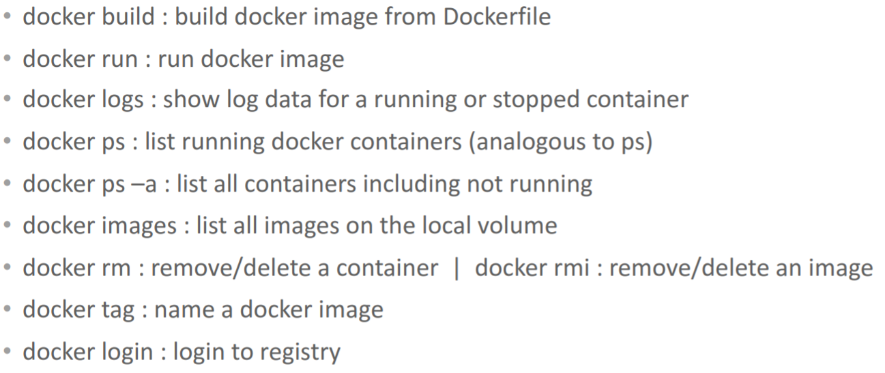
Summary of docker commands

Slide 19
Docker and container: Hands-on
Install software on container
apt-get update
apt-get install vim
apt-get install nodejs
apt-get install npm
This installs the software you will use during this session and exits the container
docker ps –a
This generates a list of all of the containers that have been run.
docker commit <old_container> <new_name>
Creates an image with the name <new_name>
docker images
run –i –t <new_name>
Ctrl+d
to exit container
Docker restart <container_id> to restart the container

Slide 20
Building Container Images
What is a Docker File?
A Dockerfile is a text document that contains all the commands you would normally execute manually in order to build a Docker image. Docker can build images automatically by reading the instructions from a Dockerfile.
Can be versioned in a version control system like Git or SVN, along with all dependencies
Docker Hub can automatically build images based on dockerfiles on Github
We all know the importance of dockerfile in creating an efficient and flexible Docker Image. A dockerfile contains a set of instructions that are executed step by step when you use the docker build command to build the docker image. It contains certain instructions and commands that decides the structure of your image, the amount of time taken to build the image, contains instructions related to docker build context, contains information related to the packages and libraries to be installed in the container and many more. Hence, it becomes very important to create an efficient, reusable, clean dockerfile as it contains the blueprint of the image that you will build.

Slide 21
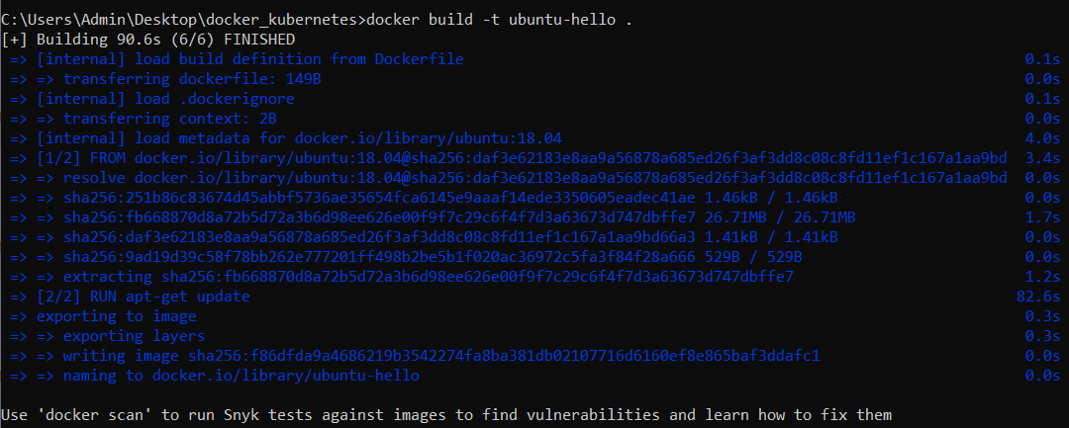
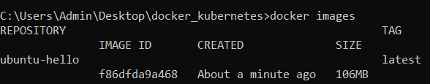
Dockerfile Example
# getting base image from ubuntu FROM ubuntu:18.04 RUN apt-get update CMD ["echo", "HEY from docker image"]
docker build -t ubuntu-hello .
docker images
docker inspect [imageId]
docker run ubuntu-hello .

Slide 22
Important keywords used in Dockerfile
FROM
You must have noticed that almost all the dockerfile starts with the FROM command. The FROM command is of the form −
A FROM command allows you to create a base image such as an operating system, a programming language, etc. All the instructions executed after this command take place on this base image. It contains an image name and an optional tag name. If you already have the base image pulled previously in your local machine, it doesn’t pull a new one. There are several pre published docker base images available in the docker registry. You can also push your own customized base image inside the docker registry.
Examples of FROM instruction along with different base images are −
FROM ubuntu
FROM centos
FROM python:3
FROM <image name>:<tag name>

Slide 23
Important keywords used in Dockerfile
RUN
A RUN instruction is used to run specified commands. You can use several RUN instructions to run different commands. But it is an efficient approach to combine all the RUN instructions into a single one.
Each RUN command creates a new cache layer or an intermediate image layer and hence chaining all of them into a single line, becomes efficient. However, chaining multiple RUN instructions could lead to cache bursts as well.
Some example of RUN commands are: You can chain multiple RUN instructions in the
following way:
RUN apt−get −y install vim RUN apt−get −y update
RUN apt−get −y update \ && apt−get −y install firefox \ && apt−get −y install vim

Slide 24
Important keywords used in Dockerfile
CMD
If you want to run a docker container by specifying a default command that gets executed for all the containers of that image by default, you can use a CMD command. In case you specify a command during the docker run command, it overrides the default one. Specifying more than one CMD instructions, will allow only the last one to get executed.
Example of a CMD command −
If you specify the above line in the dockerfile and run the container using the following command without specifying any arguments, the output will be “Welcome to MSRIT”
Output − “Welcome to MSRIT”
In case you try to specify any other arguments such as /bin/bash, etc, the default CMD command will be overridden.
CMD echo "Welcome to MSRIT"
docker run −it <image_name>

Slide 25
Important keywords used in Dockerfile
ENTRYPOINT
The difference between ENTRYPOINT and CMD is that, if you try to specify default arguments in the docker run command, it will not ignore the ENTRYPOINT arguments. The exec form of an ENTRYPOINT command is −
ENTRYPOINT [“<executable-command>”, “<parameter 1>”, “<parameter 2>”, ….]
If you have used the exec form of the ENTRYPOINT instruction, you can also set additional parameters with the help of CMD command. For example −
Running docker run command without any argument would output −
Welcome to MSRIT Hello World!
If you specify any other CLI arguments, “Hello World!” will get overridden.
ENTRYPOINT ["/bin/echo", "Welcome to MSRIT"] CMD ["Hello World!"]

Slide 26
Important keywords used in Dockerfile
WORKDIR :You can specify your working directory inside the container using the WORKDIR instruction. Any other instruction after that in the dockerfile, will be executed on that particular working directory only.
For example, Sets the working directory to /usr/src/app inside the container.
COPY: This instruction allows you to copy a directory from your local machine to the docker container. This would copy all the files inside the directory ∽/Desktop/myapp in your local machine to your current working directory inside the docker container. For example,
LABEL You can use a LABEL instruction to add description or meta data for a docker image. Its a key−value pair.
WORKDIR /usr/src/app
FROM ubuntu WORKDIR /usr/src/app COPY ∽/Desktop/myapp .
LABEL description="This is a sample image"

Slide 27
Important keywords used in Dockerfile
ADD
Similar to COPY instruction, you can use ADD to copy files and folders from your local machine to docker containers. However, ADD also allows you to copy files from a URL as well as a tar file.
For example, Would copy all the contents inside the tar file to /usr/src/app inside the container.
This command would copy all the files inside the github url to the destination.
EXPOSE
The EXPOSE instruction inside the dockerfile informs that the container is listening to the specified port in the network. The default protocol is TCP. Example
Will map the 8080 port to the container. You can use the −p flag with the docker run command to make the container listen to another container or the host machine.
ADD ∽/Desktop/myapp/practice.tar.gz /usr/src/app
ADD <URL such as a github url> <Destination path inside the container>
EXPOSE 8080

Slide 28
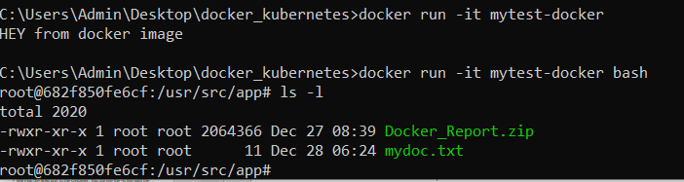
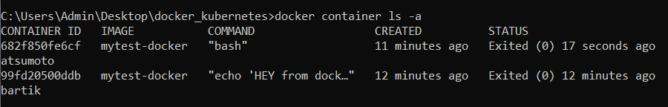
Running commands together in a Docker file.
Dockerfile
Commands to Execute
docker build -t mytest-docker .
docker run -it mytest-docker
docker run -it mytest-docker bash
docker images
docker container ls -a
# getting base image from ubuntu
FROM ubuntu:18.04
RUN apt-get update
RUN ["apt-get", "install", "-y", "vim"]
LABEL description="This is a sample image"
CMD ["echo", "HEY from docker image"]
WORKDIR /usr/src/app
#copy mydoc.txt inside the in your local machine to your
#current working directory inside the docker container.
COPY mydoc.txt .
ADD Docker_Report.zip /usr/src/app
Try vim command inside shell

Slide 29
Multi-stage builds
One of the most anticipated features of Docker’s recent 17.05 release is multi-stage builds.
Multi-stage builds are a method of organizing a Dockerfile to minimize the size of the final container, improve run time performance, allow for better organization of Docker commands and files, and provide a standardized method of running build actions.
A multi-stage build is done by creating different sections of a Dockerfile, each referencing a different base image. This allows a multi-stage build to fulfill a function previously filled by using multiple docker files, copying files between containers, or running different pipelines.
With a docker multistage build, you can create better container images.
The real reasons behind a docker multistage build are security and efficiency.
Security because in the end you copy your binary files, and only your binary files, into the final environment, reducing the surface of attacks (that is, the potential features that a hacker might exploit).
Efficiency because in this way you can ship a more lightweight version of the system, which will save a significant amount of RAM, especially when operating at scale with many containers. If you save 100MB per container, as soon as you spin 10 containers you would have saved 1GB of RAM.

Slide 30
Before multi-stage builds
One of the most challenging things about building images is keeping the image size down. Each RUN, COPY, and ADD instruction in the Dockerfile adds a layer to the image, and you need to remember to clean up any artifacts you don’t need before moving on to the next layer. To write a really efficient Dockerfile, you have traditionally needed to employ shell tricks and other logic to keep the layers as small as possible and to ensure that each layer has the artifacts it needs from the previous layer and nothing else.
It was actually very common to have one Dockerfile to use for development (which contained everything needed to build your application), and a slimmed-down one to use for production, which only contained your application and exactly what was needed to run it. This has been referred to as the “builder pattern”. Maintaining two Dockerfiles is not ideal.

Slide 31
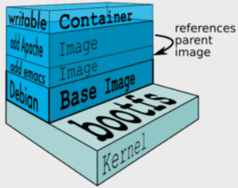
Image Construction
Docker images are made up of a series of union file system layers, the technical storage underpinnings of which is determined by the storage driver. Each executed instruction within a Dockerfile resides in its own layer of the final Docker image. The first layer will always be the inherited base image, as defined by the FROM instruction. Each subsequent layer will store your application, files, etc.
How layers are constructed affects the build time, storage, and overall performance of your application. The more instructions we have (for example RUN, COPY, ADD) in our Dockerfile, the greater the final size of the image.
There are many other things that are responsible for increasing the size of the image, like the context, base image, unnecessary dependencies, packages, and a number of instructions.
With the new multi-stage build feature, we can concisely define multiple build steps and arrive at a final Docker image that meets best practices for production.
Use alpine images wherever possible
Alpine image is a minimal Docker image based on Alpine Linux with a complete package index and only 5 MB in size!

Slide 32
How to do a Docker Multistage Build
To do a docker multistage build, you simply have to use one or more FROM statement in your dockerfile. Each new FROM statement indicates that a new step is starting. You should also pair the FROM statement with AS so that you can give a name to each step, you will need it later.
Then, you can run all the normal commands in each step. Additionally, for the COPY command you have the –from which allows you to copy data from a previous stage, rather than from the directory where you are building the container.
In this way, you can build on a stage, have the files there, and then copy them from a stage to the next. That is the whole purpose of docker multistage build.

Slide 33
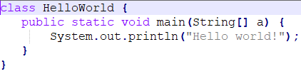
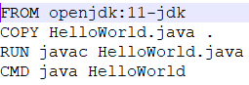
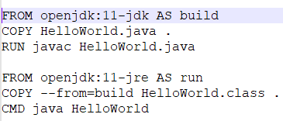
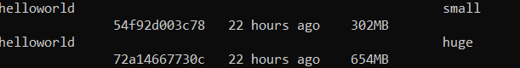
Multi-Stage Docker Build Examples
Java Example:To understand the concept of Multi-stage Docker builds better, let us consider a simple Java Hello World application.
HelloWorld.java Dockerfile to_execute
Build the image with the following command
docker build -t helloworld:huge .
Build the image with the following command
docker build -t helloworld:small .
Let’s modify our Dockerfile with the following content to show how multi-stage Docker build works.
You can see the difference in size between the two images. This way, you can separate the build and runtime environments in the same Dockerfile. Use build environment as a dependency [COPY --from=build HelloWorld.class .] while creating the Dockerfile with the approach of multi-stage docker build. This will help minimize the size of Docker images.
Now, let’s compare both images. Check the images created with the following command,
docker images

Slide 34
Node.Js Example
get_ex1.js
index.html
var express = require('express');
var app = express();
app.get('/index.html', function (req, res) {
res.sendFile( __dirname + "/" + "index.html" );
})
app.get('/process_get', function (req, res) {
response = {
first_name:req.query.first_name,
last_name:req.query.last_name
};
console.log(response);
console.log("Sent data are (GET): first name :"+req.query.first_name+" and last name :"+req.query.last_name);
//res.end(JSON.stringify(response));
res.end("Sent data are (GET): first name :"+req.query.first_name+" and last name :"+req.query.last_name);
})
var server = app.listen(8080, function () {
var host = server.address().address
var port = server.address().port
console.log("Example app listening at http://%s:%s", host, port)
})
<html>
<body>
<form action="process_get" method="get">
First Name: <input type="text" name="first_name"> <br>
Last Name: <input type="text" name="last_name">
<input type="submit" value="Submit">
</form>
<a href="form.html">Google</a>
<a href="/">welcome</a>
</body>
</html>

Slide 35
Node.Js Example
Dockerfile (normal)
Docker file (multi-stage build)
FROM node:14-alpine
ADD . /app
WORKDIR /app
COPY package.json .
RUN npm install --production
COPY . .
EXPOSE 8080
CMD [ "node", "get_ex1.js" ]
FROM node:14-alpine as base
ADD . /app
WORKDIR /app
COPY package.json .
RUN npm install --production
FROM node:10-alpine
WORKDIR /app
COPY --from=base /app /app
EXPOSE 8080
CMD [ "node", "get_ex1.js" ]
docker build -t helloworld:nodebig .
docker run -p 3002:8080 -d helloworld:nodebig
docker build -t helloworld:nodesmall .
docker run -p 3003:8080 -d helloworld:nodesmall

Slide 36
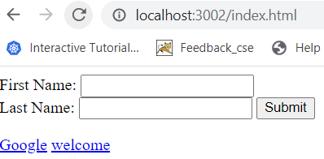
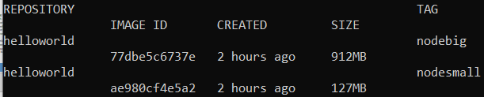
Now, compare the image sizes. One with the usual Dockerfile is 48.81 MB, and the other created with a multi-stage Docker build. The image created by the multi-stage Docker build approach is more optimized.
To check output on the browser: http://localhost: 3002 (3003)

Slide 37
Use multi-stage builds
With multi-stage builds, you use multiple FROM statements in your Dockerfile. Each FROM instruction can use a different base, and each of them begins a new stage of the build. You can selectively copy artifacts from one stage to another, leaving behind everything you don’t want in the final image. To show how this works, let’s adapt the Dockerfile from the previous section to use multi-stage builds.

Slide 38
Storing and Distributing Images
Docker Hub
Docker Hub is a service provided by Docker for finding and sharing container images with your team. It’s the world’s largest repository of container images with an array of content sources including container community developers, open source projects and independent software vendors (ISV) building and distributing their code in containers.
Users get access to free public repositories for storing and sharing images or can choose a subscription plan for private repositories.
Docker Hub provides the following major features:
Repositories: Push and pull container images.
Teams & Organizations: Manage access to private repositories of container images.
Docker Official Images: Pull and use high-quality container images provided by Docker.
Docker Verified Publisher Images: Pull and use high- quality container images provided by external vendors.
Builds: Automatically build container images from GitHub and Bitbucket and push them to Docker Hub.
Webhooks: Trigger actions after a successful push to a repository to integrate Docker Hub with other services.
Users looking for a zero maintenance, ready-to-go solution are encouraged to head-over to the Docker Hub, which provides a free-to-use, hosted Registry, plus additional features (organization accounts, automated builds, and more).

Slide 39
Building and Running a Container on a Local Machine
Building a Docker image:
Executing the docker build command downloads the base image indicated in the Dockerfile from Docker Hub, and then Docker executes the various instructions that are mentioned in the Dockerfile.
At the end of the execution, obtain a locally stored Docker demobook image.
Check if the image is successfully created by executing the following Docker command:
docker images

Slide 40
Building and Running a Container on a Local Machine
Instantiating a new Container of an Image:
To instantiate a container of Docker image created, execute the docker run command in the Terminal with the following syntax:
docker run -d --name demoapp -p 8080:80 demobook:v1
The -d parameter indicates that the container will run in the background.
In the -name parameter, we indicate the name of the container we want.
In the -p parameter, we indicate the desired port translation; that is, in our example, port 80 of the container will be translated to port 8080 on our local machine.

Slide 41
Building and Running a Container on a Local Machine
Instantiating a new Container of an Image:
And finally, the last parameter of the command is the name of the image and its tag.
The execution of this command is shown in the following screenshot:
This command displays the ID of the container, and the container runs in the background.
It is also possible to display the list of containers running on the local machine, by executing the following command:

Slide 42
Building and Running a Container on a Local Machine
Instantiating a new Container of an Image:
docker ps
The following screenshot shows the execution with our container:

Slide 43
Building and Running a Container on a Local Machine
Testing a Container locally :
Everything that runs in a container remains inside it.
This is the principle of container isolation.
However, with the port translation and with the run command, you can test your container on your local machine.
To do this, open a web browser and enter http://localhost:8080 with 8080, which represents the translation port indicated in the command, and here is the result:

Slide 44
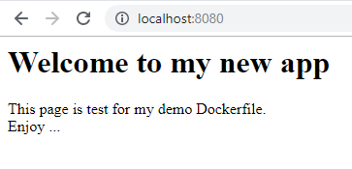
Building and Running a Container on a Local Machine
Testing a Container locally :

Slide 45
Pushing an image to Docker Hub
The goal of creating a Docker image that contains an application is to be able to use it on servers that contain Docker and host the company's applications.
In order for an image to be downloaded to another computer, it must be saved in a Docker image registry.
There are several Docker registries that can be installed on-premise.
If you want to create a public image, you can push it (or upload it) to Docker Hub, which is Docker's public (and free) registry.

Slide 46
Pushing an image to Docker Hub
To push a Docker image to Docker Hub, perform the following steps:
1. Sign in to Docker Hub: Log in to Docker Hub using the following command: docker login -u <your dockerhub login>
2. Retrieving the image ID: The next step consists of retrieving the ID of the image that has been created. Execute the docker images command to display the list of images with their ID.

Slide 47
Pushing an image to Docker Hub
To push a Docker image to Docker Hub, perform the following steps:
3. Tag the image for Docker Hub: With the ID of the image we retrieved, we will now tag the image for Docker Hub. To do so, the following command is executed: docker tag <image ID> <dockerhub login>/demobook:v1

Slide 48
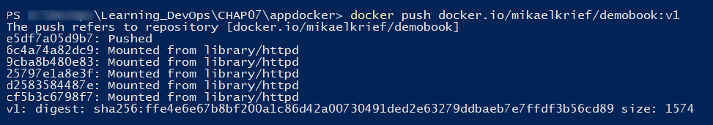
Pushing an image to Docker Hub
4. Push the image Docker in the Docker Hub: After tagging the image, the last step is to push the tagged image to Docker Hub.
Execute the following command:
docker push <dockerhub login>/demobook:v1

Slide 49
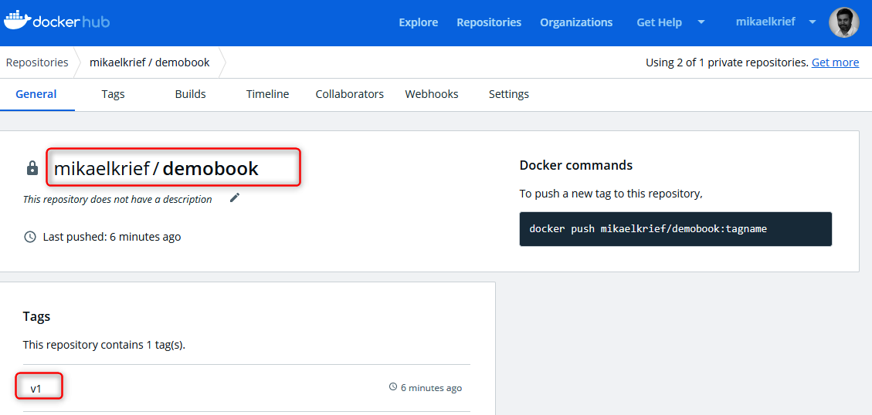
Pushing an image to Docker Hub
To view the pushed image in Docker Hub, connect to the Docker Hub web portal at https://hub.docker.com/ and see that the image is present.

Slide 50
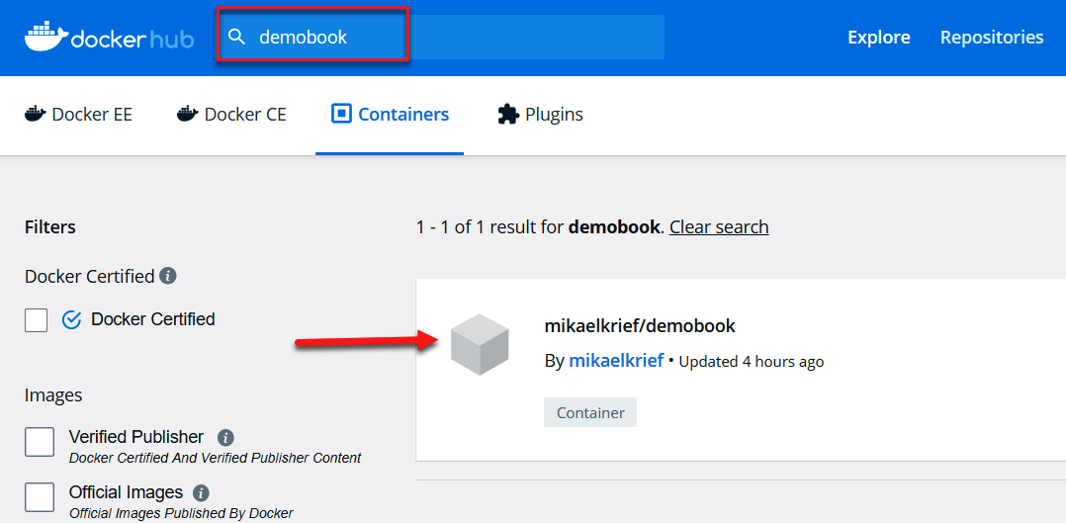
Pushing an image to Docker Hub
By default, the image pushed to Docker Hub is in public mode – everybody can view it in the explorer and use it.

Slide 51
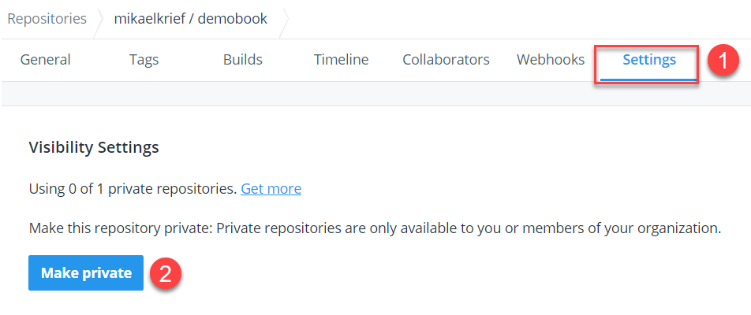
Pushing an image to Docker Hub
To make this image private – that is, you must be authenticated to be able to use it – you must go to the Settings of the image and click on the Make private button:

Slide 52
Storing and Distributing Images
Docker Store :Docker Store and Docker Cloud are now part of Docker Hub, providing a single experience for finding, storing and sharing container images.
Docker Registry
The Registry is a stateless, highly scalable server side application that stores and lets you distribute Docker images. The Registry is open-source, under the permissive Apache license. You can find the source code on GitHub.
You should use the Registry if you want to:
tightly control where your images are being stored
fully own your images distribution pipeline
integrate image storage and distribution tightly into your in-house development workflow

Slide 53
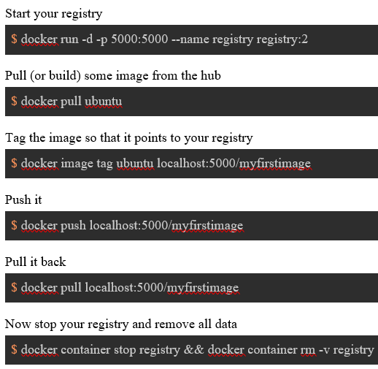
Docker Registry
The Registry is compatible with Docker engine version 1.6.0 or higher.
Basic commands
docker start registry
get a list of images on docker registry v2
$http://localhost:5000/v2/_catalog
To login to Registry
$docker login localhost:5000

Slide 54
Docker Trusted Registry
Docker Trusted Registry (DTR) is the enterprise-grade image storage solution from Docker. You install it behind your firewall so that you can securely store and manage the Docker images you use in your applications.
Docker trusted registry or simply Docker registry is an enterprise offering from Docker. The most common terminology that you will hear with Docker Enterprise Edition is DTR and UCP (universal control plane).
In order for DTR to work UCP has to be installed and for UCP to be installed you would need Docker Enterprise Edition. Once you install Docker EE you can get a free license from DockerHub.

Slide 55
DTR Features
Image and job management: DTR can be installed on any platform where you can store your Docker images securely, behind your firewall. DTR has a user interface that allows authorized users in your organization to browse Docker images and review repository events. It even allows you to see what Dockerfile lines were used to produce the image and, if security scanning is enabled, to see a list of all of the software installed in your images.
Availability: DTR is highly available as it has multiple replicas of containers in case anything fails.
Efficiency: DTR has this ability to clean the unreferenced manifests and cache the images as well for faster pulling of images.
Built-in access control : STR has great authentication mechanisms like RBAC , LDAP sync. It uses the same authentication as of UCP.
Security scanning: Image Scanning is built in feature provided out of the box by DTR.
Image signing: DTR has built in Notary, you can use Docker Content Trust to sign snd verify images.

Slide 56
Azure container Registry
Azure Container Registry allows you to build, store, and manage container images and artifacts in a private registry for all types of container deployments. Use Azure container registries with your existing container development and deployment pipelines. Use Azure Container Registry Tasks to build container images in Azure on-demand, or automate builds triggered by source code updates, updates to a container's base image, or timers.

Slide 57
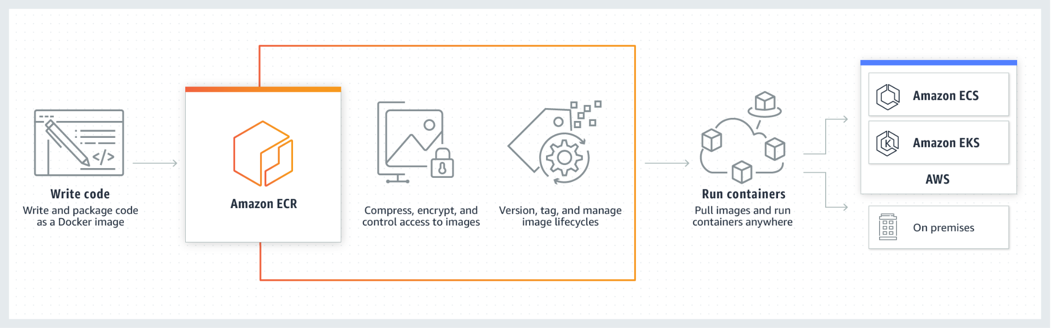
Amazon ECR
Push container images to Amazon ECR without installing or scaling infrastructure, and pull images using any management tool.
Share and download images securely over Hypertext Transfer Protocol Secure (HTTPS) with automatic encryption and access controls.
Access and distribute your images faster, reduce download times, and improve availability using a scalable, durable architecture.
How it works :Amazon ECR is a fully managed container registry offering high-performance hosting, so you can reliably deploy application images and artifacts anywhere.

Slide 58
Managing Containers
A container is a runnable instance of an image. You can create, start, stop, move, or delete a container using the Docker API or CLI. You can connect a container to one or more networks, attach storage to it, or even create a new image based on its current state.
By default, a container is relatively well isolated from other containers and its host machine. You can control how isolated a container’s network, storage, or other underlying subsystems are from other containers or from the host machine.
A container is defined by its image as well as any configuration options you provide to it when you create or start it. When a container is removed, any changes to its state that are not stored in persistent storage disappear.

Slide 59
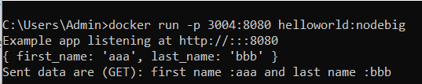
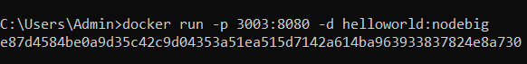
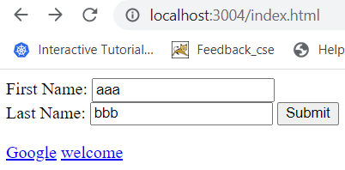
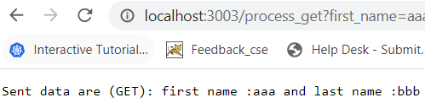
Run a Container in the attached/Detached Mode
There are two ways of running a container – in attached mode (in the foreground) or in detached mode (in the background).
In the attached mode, Docker can start the process in the container and attach the console to the process’s standard input, standard output, and standard error.
In a detached mode container runs in the background and returns a terminal to perform other tasks. However, sometimes we need to connect to a container to perform a few tasks.
If you want to keep the container and current terminal session separate, you can run the container in the background using the -d attribute. Using detached mode also allows you to close the opened terminal session without stopping the container.
The command for running a container in the background is:
docker container run -d [docker_image]
Run node application in attached mode
docker run -p 3004:8080 helloworld:nodebig
Run node application in detached mode
docker run -p 3003:8080 –d helloworld:nodebig

Slide 60
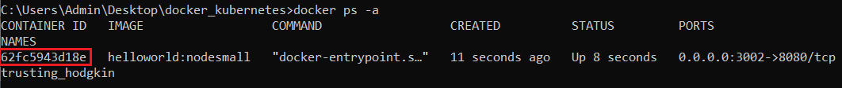
docker container rename
Get controller ID
Rename the controller ID with name node_small_cong

Slide 61
List Containers
Fetch the logs of a container
Run a command in a running container
List port mappings or a specific mapping for the container

Slide 62
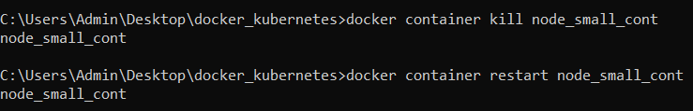
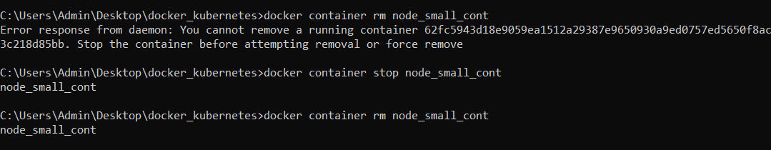
Kill and restart container
Remove container: First you have to stop the container and then remove

Slide 63
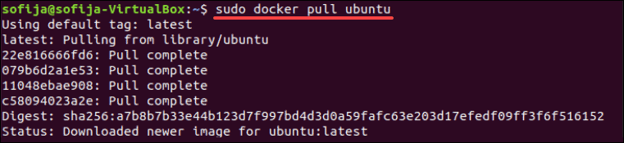
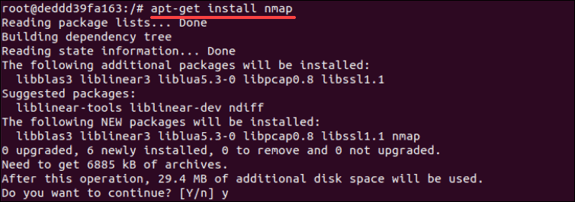
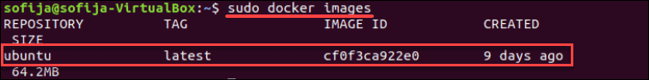
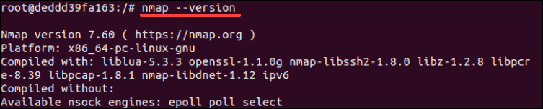
Committing Changes to Docker Image
Step 1: Pull a Docker Image Step 3: Modify the Container
You can verify the installation by running:
Step 2: Deploy the Container

Slide 64


Docker commit
4. You will need the CONTAINER ID to save
the changes you made to the existing
image. Copy the ID value from the output.
5. Commit Changes to Image
6. Your newly created image should now
be available on the list of local images.

Slide 65

Docker Network
Why is networking important in Docker?
A Container, being a form of virtualization, acts as an isolated system from the Docker host and from other containers. Oftentimes, we need to connect multiple containers to produce a useful outcome.
For Docker containers to communicate with each other and the outside world via the host machine, there has to be a layer of networking involved. Docker supports different types of networks, each fit for certain use cases.
For example, building an application which runs on a single Docker container will have a different network setup as compared to a web application with a cluster with database, application and load balancers which span multiple containers that need to communicate with each other. Additionally, clients from the outside world will need to access the web application container.

Slide 66
Types of Networks in Docker
bridge: the default network driver
host: for standalone containers
none: networking is disabled
overlay: used in Docker swarm
macvlan: works on MAC addresses assigned to containers
User defined network
Network plugins: Third-party network plugins with Docker.
Docker uses the default bridge network driver if no driver is stated.

Slide 67

Docker network commands

Slide 68



Hands on
The default bridge network
docker network ls
docker run -itd --name=networktest ubuntu
docker network inspect bridge
docker network disconnect bridge networktest

Slide 69




User defined network
Create and connect a container to a user-defined bridge
docker network create my-net
docker network ls
docker run -d --net my-net -p 3002:80 nginx:latest
docker inspect my-net
localhost:3002

Slide 70

Test network connectivity
The output to the previous docker network inspect command shows the IP address of the new container. In the previous example it is “172.19.0.2” but yours might be different.
You can get the IP from the command line by the following command
docker inspect -f '{{range.NetworkSettings.Networks}}{{.IPAddress}}{{end}}' <cont_id>
Then user docker exec with curl command to reach the nginx website from the docker host
docker ps -a
docker inspect -f '{{range.NetworkSettings.Networks}}{{.IPAddress}}{{end}}' <cont_id>
docker exec –it <cont_id> <ip>
Remove container, image and then remove network
docker network rm my-net

Slide 71

Docker network none
What is the none network driver?
The none driver simply disables networking for a container, making it isolated from other containers.
Within the container, only the loopback interface is created to enable inter-process-communication, by using the IP address 127.0.0.1 mapping to the name localhost.
But the absence of other network interfaces like eth0 means, neither can it reach external networks nor can external networks reach it.
This makes the none network driver very secure. But it also limits its usability, as we usually wish to enable communication between containers
.

Slide 72

How to use the none network driver?
First, we’ll run an interactive shell (sh) within an alpine Linux container named app1, without specifying a network:
docker run -it --name app1 alpine sh
ip addr
route
ping google.com

Slide 73

How a container with the none driver behaves
Open a new terminal tab/window and run a very similar container like before. This time we will specify the network to be none and name it app2.
docker run -it --name app2 --network none alpine sh
ping google.com
##will not work
ping localhost
##will ping to localhost
ip addr ## no Ethernet
route ## no route

Slide 74
When to use the none network driver? –
possible use cases
To run network-isolated applications that only perform file operations: This could be done by mounting volumes to the container, which then, in turn, could perform operations after certain intervals or by detecting file change events. Some examples include using a container for generating database backups, processing log files, etc.
To run a one-off command which requires network-isolation: Sometimes it might be required to just perform computations and print logs in a secure, network-isolated environment. Examples include running ci/cd jobs that export produced artifact files or testing suspicious scripts that could contain malware, etc.

Slide 75

Docker network host
In Docker, the host is a machine responsible for running one or more containers. Docker network host, also known as Docker host networking, is a networking mode in which a Docker container shares its network namespace with the host machine.
In docker network host the container will share the host’s networking namespace. There is no IP-address assignment is made to the container in this network mode. In this mode, port-mapping options such as ‘-p’, ‘-publish’, ‘-P’ and ‘–publish-all’ is ignored, which means we cannot publish any port for the container or in other words, published ports are discarded by the Docker daemon when using host network mode.

Slide 76
How to work with network host in docker?
We have to use the ‘–network’ option and specify ‘host’ as an argument to use the host network driver while running a container. As we know now, the container does not get any IP address assigned when using the host network driver that means if we bind to port 80 to a running container and the container is using the host network, then the application running inside the container is available on port 80 on the host’s IP address, it also means we cannot bind the same port to two different containers. Host network mode is used to optimize performance as it does not require network address translation. This driver only works on Linux hosts, and it is not supported on Docker Desktop for Mac, Docker Desktop for Windows, or Docker EE for Windows Server.

Slide 77

Hands on
Example-1: Create an nginx container and try to access it externally without exposing the port.
docker run -d --network host --name my_nginx nginx:alpine
open browser (works in linux only)
localhost:80 ## will disply nginx page
We can see that the nginx server is easily accessible locally on port 80 without exposing any port from the host to the container. It is because the host network is directly shared with the container.
docker network create host2 --driver=host
In the above example, we have tried to create a host network named ‘host2’; however, it did not work as we can only create one host network locally.

Slide 78

Example-2: let’s create another nginx container and see if it is possible or not.
docker run -d --network host --name my_nginx2 nginx:alpine
docker ps -a
docker logs <cont_id>
# shows Address in use
In this example, we have tried to create another container named ‘my_nginx2’; however, if we check the container status, it is in exited status as shown in snapshot.
Let’s check the logs to understand the reason. So, in the snapshot, it says, ‘Address in use’ because port 80 is used by an already running container.
Note: We cannot run more than one container which is listening on the same port while using host network mode; however, we can run a container that is listening on a different port.

Slide 79

Docker network bridge
The bridge driver creates an internal network within a single Docker host. containers placed within this network can communicate with each other but are isolated from containers, not on the internal network. bridge is the default driver when running single containers or when using docker-compose.
When we start Docker, a default bridge network is created automatically, and newly-started containers connect to it.
In docker, a bridge network uses a software bridge which allows containers connected to the same bridge network to communicate, while providing isolation from containers which are not connected to that bridge network. The Docker bridge driver automatically installs rules in the host machine so that containers on different bridge networks cannot communicate directly with each other.

Slide 80

Hands on
Let us inspect bridge network
By default, the Docker server creates and configures the host system's an ethernet bridge device, docker0.
Note that this network has no containers attached to it yet.
Docker will attach all containers to a single docker0 bridge, providing a path for packets to travel between them.
All networks created with the bridge driver are based on a Linux bridge.
Though we cannot remove this default bridge network, we can create new ones using the network create command. We can attach a new container by specifying the network name while it's being created.

Slide 81


docker network interfaces
Let's create a container and see how the bridge network works.
docker run -it alpine sh
ip a
## Open another terminal
docker network inspect bridge
Now we can see we have a new container attached to the bridge network.

Slide 82



Creating a custom (user defined) docker bridge network and attaching a container to the network
docker network create -d bridge my-bridge-network
docker network ls
docker run -d -p 8088:80 --name nginx-server1 nginx:alpine
docker inspect nginx-server1
localhost:8088

Slide 83



custom docker bridge
Then, we want to launch the second container from nginx:alpine with a name "nginx-server2" in detached mode. This container will be using the custom bridge network, my-bridge-network we've just created.
docker run -d -p 8788:80 --network="my-bridge-network" --name nginx-server2 nginx:alpine
docker inspect nginx-server2
localhost:8788

Slide 84


custom docker bridge
The 2nd server not talking to the 1st server since they are in different networks. To make sure we can try with IP address: It’s not working.

Slide 85


custom docker bridge
Let's remove the 1st server and recreate it into the customized bridge network.
docker container rm -f nginx-server1
docker run -d -p 8088:80 --network="my-bridge-network" --name nginx-server1 nginx:alpine
Let's go into the 2nd container and check if we can ping to the 1st container:
docker exec -it nginx-server2 sh
ping nginx-server1
We can see they are now talking each other (hostnames are recognized) since they are in the same network!

Slide 86

Docker Volumes
Docker volumes are used to persist the docker container data on the host system to avoid data loss in case of a crashed docker container. Docker volume stores all the data on the host system and data persists even in case a container goes down.
Docker volumes are dependent on Docker’s file system and are the preferred method of persisting data for Docker containers and services. When a container is started, Docker loads the read-only image layer, adds a read-write layer on top of the image stack, and mounts volumes onto the container file system.

Slide 87
Container Immutability
When a Docker container is destroyed, creating a new container off of the existing Docker image does so without making any changes to the original container. Therefore, you’ll lose data any time you destroy one container and create a new one.

Slide 88


Where are docker images are stored?
In windows

Slide 89


Way to store the data
In addition, volumes are often a better choice than persisting data in a container’s writable layer, because a volume does not increase the size of the containers using it, and the volume’s contents exist outside the lifecycle of a given container.

Slide 90

Docker volume commands

Slide 91


Docker volume create command
docker volume create my-vol
docker run --mount source=[volume_name],destination=[path_in_container] [docker_image]
docker run -it --name=voltest --mount source=my-vol,destination=/mydata1 alpine
docker run -itd -v [volume_name]:/my-vol:/[path_in_container] [docker_image]
docker run -itd -v my-vol:/mydata alpine
In general, --mount is more explicit and verbose. The biggest difference is that the -v syntax combines all the options together in one field, while the --mount syntax separates them.
Remember if the volume doesn’t exist Docker will create it for you.

Slide 92



Create and manage volumes
Start a container with a volume using –v
docker volume create my-vol
docker volume inspect my-vol
docker volume ls
docker run -itd -v my-vol:/mydata alpine

Slide 93


Create and manage volumes
List the contents of the container to see if the volume is mounted successfully.

Slide 94



Create and manage volumes
List the contents of the container to see if the volume is mounted successfully after recreation
Start a container with a volume using –mount
docker run -it --name=voltest --mount source=my-vol,destination=/mydata1 alpine
List of containers running inside docker volume
docker ps -a --filter volume=my-vol --format "{{.Names}}"

Slide 95
What are Bind Mounts in Docker?
A Bind Mount is a storage area (file/directory) on your local machine available inside your container. So any changes you make to this storage space (file/directory) from the outside container will be reflected inside the docker container and vice-versa.
A practical application of Bind Mounts can be when you want to update the source code of your image and run it inside the container without creating a new image. You can do so by creating a Bind Mount and changing the code from your local machine, which will then reflect in your container.
Please Note: A bind mount will overwrite the content of the docker container.

Slide 96
Example
We will be running a container from an Nginx image and use a bind-mount to mount a directory from the host machine into the container.
Create an empty directory “example” located at “f:\mylocal_volume” on a local machine, and I want to access the content of this directory at the location “/app/example” from within my container.
The command for running a container with the above requirements will be:
docker run -d --name bind-mount -v f:\my_local_volume\example:/app/example nginx:1.16.0

Slide 97



We will try creating a file in the “example” directory on the host machine and then check if it is available from inside the container.
We created an empty text file named “Hello.” Let’s bash into the container and check if we can access it from there. The command for that will be :
We notice that the “mytext.txt” file is available inside the container. Now let’s create a file inside the container and check if it’s available on the local machine.
docker exec -it bind-mount bash
We can observe that the changes are reflected on the host machine also. Delete the container and see if data is persisted on your local machine

Slide 98

Use Docker Volumes to Persist Changes
Let’s create a Docker volume and mount it to persist MySQL data:
create volume
docker volume create mysql-data
run mysql container in the background
docker run --name mysql-db -v mysql-data:/var/lib/mysql -e MYSQL_ROOT_PASSWORD=my-secret-pw -d mysql:latest

Slide 99

Inside the container
mysql -u root -p
Enter password : my-secret-pw
mysql> create database mydb;
mysql> use mydb
stop mysql container
docker rm -f mysql-db

Slide 100


Remove and re-create the container and observe database mydb still exists
Re-run mysql container in the background
docker run --name mysql-db -v mysql-data:/var/lib/mysql -e MYSQL_ROOT_PASSWORD=my-secret-pw -d mysql:latest

Slide 101
Docker compose
Docker Compose is a tool that assists in defining and sharing multi-container applications. By using Compose, we can define the services in a YAML file, as well as spin them up and tear them down with one single command.
To configure the orchestration, Docker Compose uses a docker-compose.yml file. It specifies what images are required, what ports they need to expose, whether they have access to the host filesystem, what commands should be run when they start up, and so on.

Slide 102
Benefits of Docker Compose
Single host deployment - This means you can run everything on a single piece of hardware
Quick and easy configuration - Due to YAML scripts
High productivity - Docker Compose reduces the time it takes to perform tasks
Security - All the containers are isolated from each other, reducing the threat landscape

Slide 103
Basic Commands in Docker Compose
Start all services: Docker Compose up
Stop all services: Docker Compose down
Check the version of Docker Compose: Docker-compose-v
Run Docker Compose file: Docker-compose up -d
List the entire process: Docker ps
Scale a service - Docker Compose up -d -scale
Use YAML files to configure application services - Docker Compose.yml
docker-compose version
Install Docker Compose

Slide 104
Install Docker Compose on Linux
To run Docker Compose on Linux, we need to download the Docker Compose binary using Github’s Compose repository release page.
Follow the below instructions to successfully install the Docker Compose -
To download the current stable version of the Docker Compose, run the below command -
To the binary, apply for the executable permissions.
Next, go for installation testing by running the below command.
sudo curl -L "https://github.com/docker/compose/releases/download/<version>/docker-compose-$(uname -s)-$(uname -m)" -o /usr/local/bin/docker-compose
2. using pip: pip install -U Docker-compose
3. For using Docker Compose on Windows,
we need to just have Docker Desktop for Windows installed and don’t need to install Docker Compose separately.
Docker compose installation

Slide 105

Create named docker volume with docker-compose
docker-compose.yml
version: '3.1'
services:
alp:
image: alpine
volumes:
- my-vol:/mydata
command: sleep 10000
volumes:
my-vol:
external: false
docker-compose up

Slide 106

docker-compose explained
Open another terminal
docker volume ls
docker ps
docker exec -it docker_compose-alp-1 /bin/sh

Slide 107

Local Development with Docker Compose
Docker Compose is a tool for defining and running a multi-container Docker application.
If you have an application that requires an nodejs server and mongo database, you can create a Docker Compose file that can run both the containers as a service without the need to start each one separately.

Slide 108
Running multi container using docker-compose
docker-compose.yml
The web service
The first section defines the web service. It opens port 8082 and mounts our local code directory as a volume.
version: "2"
services:
web:
build: .
ports:
- "8082:8082"
depends_on:
- mongo
mongo:
image: mongo
ports:
- "27018:27017"
The mongo service
The next service is the mongo database, which opens port 27018 and uses the latest official mongo image on Docker Hub.
Now that the local development environment is defined in docker-compose.yml, you can spin up all three services with one command:
docker-compose up
Open another terminal
docker container ls
Running docker compose up for the first time creates a volume. The same volume is reused when you subsequently run the command

Slide 109
Kubernetes VS Docker Swarm – What is the Difference?
Docker Swarm and Kubernetes are the most popular container orchestration platforms. Both of them have their specific uses and come with certain advantages and disadvantages.
Kubernetes has a more complex cluster structure than where as Docker Swarm is designed for ease of use, making it a preferable choice for simple applications.
Kubernetes is very customizable but complex to set up. Docker Swarm is easier to install and configure.
Docker Swarm offers automatic load balancing, while Kubernetes does not. However, it is easy to integrate load balancing through third-party tools in Kubernetes.
Kubernetes: Provides scaling based on traffic. Horizontal autoscaling is built in. Scaling in Kubernetes involves creating new pods and scheduling them to nodes with available resources.
Docker Swarm: Offers autoscaling of instances quickly and on-demand. As Docker Swarm deploys containers quicker, it gives the orchestration tool faster reaction times that enable on-demand scaling.

Slide 110
Advantages of Docker Swarm
Docker Swarm is quite simple to install, which is why it is well-suited for those just jumping into the container orchestration world.
It is lightweight.
Within the Docker containers, Docker Swarm provides automated load balancing.
As Docker Swarm is native to Docker, it works with the Docker CLI. In addition to that, it works seamlessly with existing Docker tools such as Docker Compose.
Docker Swarm provides intelligent node selection, which allows you to pick the optimal nodes in a cluster for container deployment.
It has its own Swarm API.
Docker Swarm challenges
Despite its numerous benefits, there are a few considerations.
Docker Swarm is strongly tied to the Docker API, which limits its functionality as compared to Kubernetes.
Customization options and extensions are limited in Docker Swarm.

Slide 111
Which platform should you use?
Both Kubernetes and Docker Swarm serve their particular use cases. Which one is best for you depends on your or your organization's current needs.
When starting, Docker Swarm is an easy-to-use solution to manage your containers at scale. If you or your company does not need to manage complex workloads, then Docker Swarm is the right choice.
If your applications are critical and you are looking to include monitoring, security features, high availability, and flexibility, then Kubernetes is the right choice.

Slide 112
Docker swarm
A Docker Swarm is a open-source container orchestration tool running the Docker application. It has been configured to join together in a cluster. The activities of the cluster are controlled by a swarm manager, and machines that have joined the cluster are referred to as nodes.
A Docker Swarm is a group of either physical or virtual machines that are running the Docker application and that have been configured to join together in a cluster.
The activities of the cluster are controlled by a swarm manager, and machines that have joined the cluster are referred to as nodes.
One of the key benefits associated with the operation of a docker swarm is the high level of availability offered for applications.
Docker Swarm lets you connect containers to multiple hosts similar to Kubernetes.
Docker Swarm has two types of services: replicated and global.
Global services are responsible for monitoring containers that want to run on a Swarm node. In contrast, replicated services specify the number of identical tasks that a developer requires on the host machine.

Slide 113
Docker swarm
Docker Swarm converts multiple Docker instances into a single virtual host. A Docker Swarm cluster is generally composed of three items:
Nodes
Services and tasks
Load balancers
Nodes are instances of the Docker engine that control your cluster alongside managing the containers used to run your services and tasks.
Load balancing is also a part of Docker Swarm clusters and it is used to route requests across nodes.

Slide 114
Advantages of Kubernetes
It has the ability to sustain and manage large and complex workloads.
It has a large open-source community, backed by Google.
Being open-source, it offers broad community support and the ability to handle varied, complex deployment scenarios.
It is offered by all main cloud providers: Google Cloud Platform, Microsoft Azure, IBM Cloud, and AWS.
It is automated and supports automatic scaling.
It is feature-rich and has built-in monitoring and a wide range of available integrations.
Kubernetes challenges
Although Kubernetes has a comprehensive feature set, it also has a few drawbacks:
The learning curve for Kubernetes is steep and it takes specialized knowledge to master Kubernetes.
The installation process is complex, especially for beginners.
As the open-source community is quite active, Kubernetes frequently requires careful patching to keep the technology updated without disrupting workloads.
For simple apps that do not need frequent deployments, Kubernetes is heavy.

Slide 115

Docker swarm: an overview
Consider an environment having Docker containers. If one of the containers fails, we can use the Swarm to correct that failure.
Docker Swarm can reschedule containers on node failures. Swarm node has a backup folder which we can use to restore the data onto a new Swarm.

Slide 116
Swarm Mode Key Concepts
Docker containers are launched using services.
Services enable developers to scale their applications.
Before deploying a service in Swarm, the developer should implement at least a single node.
Services can be used and accessed by any node of the same cluster.
A service is a description of a task, whereas a task performs the work.
Docker helps a developer in creating services, which can start tasks. However, when a task is assigned to a node, the same task cannot be attributed to another node.
Node
A Swarm node is an instance of the Docker engine.
It is possible to run multiple nodes on a single server. But in production deployments, nodes are distributed across various devices.

Slide 117

Hands-on
Initialize a swarm. The docker engine targeted by this command becomes a manager in the newly created single-node swarm.
To view a list of nodes in the swarm run docker node ls from a manager node:

Slide 118


Deploy to Swarm
localhost:8080
docker swarm init --advertise-addr 127.0.0.1
docker node ls
docker service create --name backend --replicas 2 --publish 8080:80 nginx
docker service ls
docker node ps
docker swarm leave --force

